Slide 1

Mess Management
RPOOP
PROJECT
112103077 Pranav Lande
112103078 Jaykumar Lokhande

Slide 2

Managing meals in a mess setting can be a complex and time-consuming task. The traditional manual processes often lead to inefficiencies, miscommunication, and challenges in maintaining accurate records.

Slide 3

WE have developed a Mess Management Website to address these challenges. This web-based solution offers a user-friendly interface for administrators to add, update, and manage meals. Users can view and select their desired meals in real-time

Slide 4

The Mess Management Website is built using a combination of technologies. The front-end is developed using HTML and CSS to create the website's structure and visual design.
The Mess Management Website is built using a combination of technologies. The front-end is developed using HTML and CSS to create the website's structure and visual design.
Python, with the Flask framework, powers the back-end, enabling server-side logic and database interactions.
JavaScript adds interactivity and real-time updates to enhance the user experience.
The SQL database is utilized for secure data storage and retrieval.

Slide 5

Business Impact:
"The implementation of this solution can have several positive business impacts. By automating and streamlining the meal management process, the Mess Management Website improves operational efficiency, saves time, and reduces errors. Users benefit from a seamless and transparent experience, leading to increased satisfaction and loyalty."

Slide 6
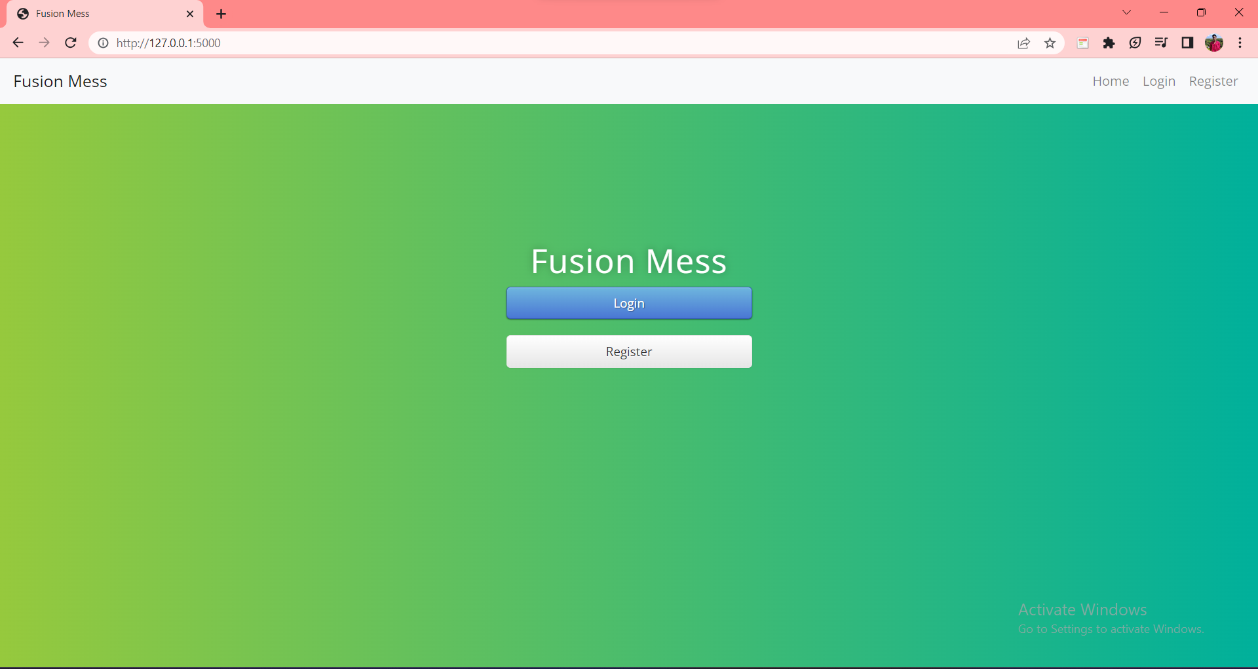
Login/Registration Page:

Slide 7
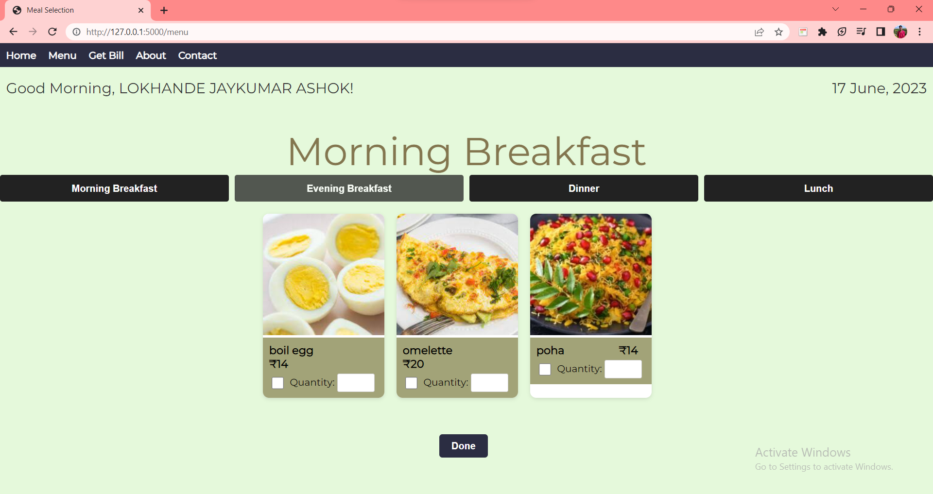
Menu Page:

Slide 8
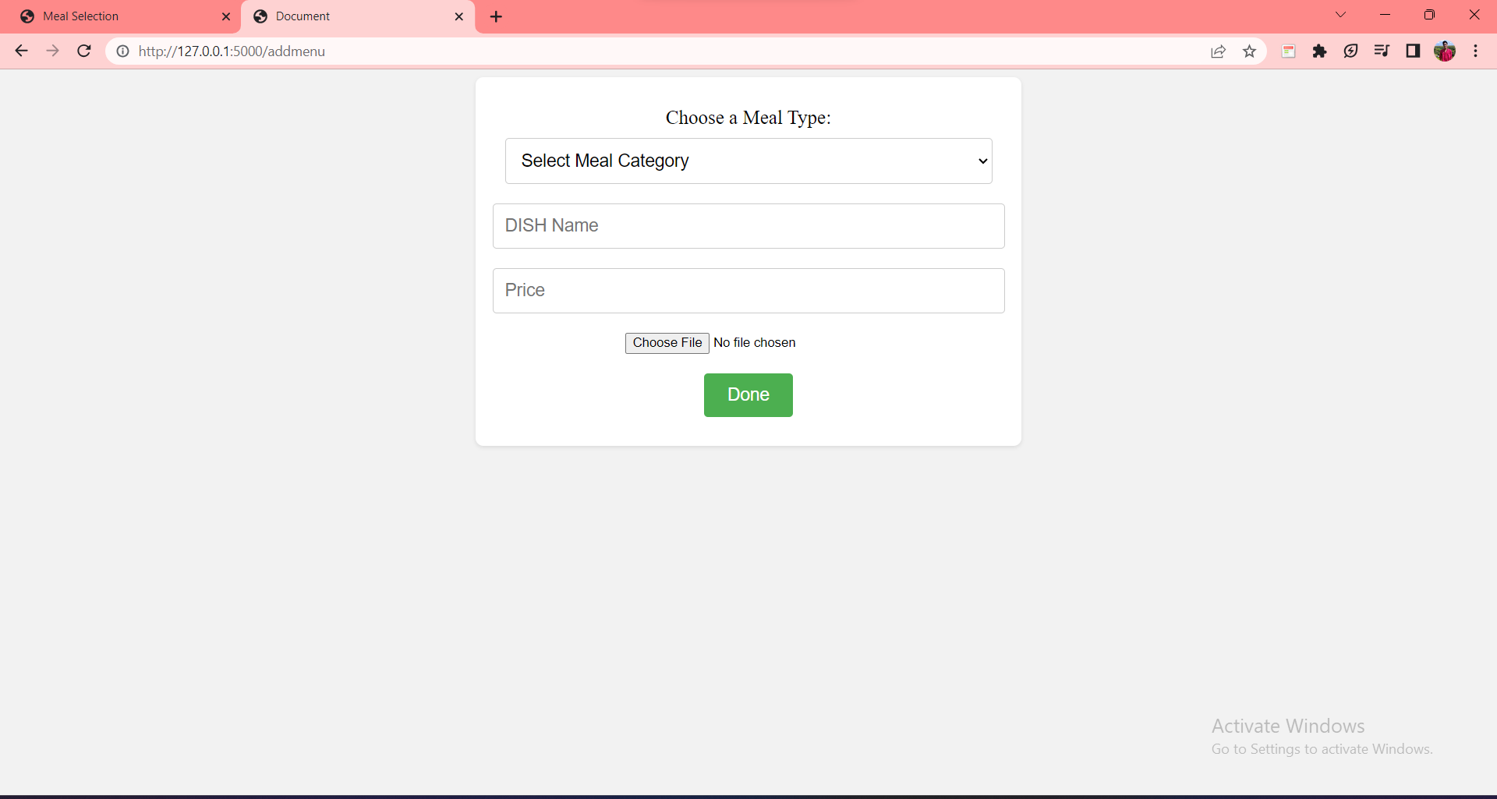
Admin Page to add meal

Slide 9
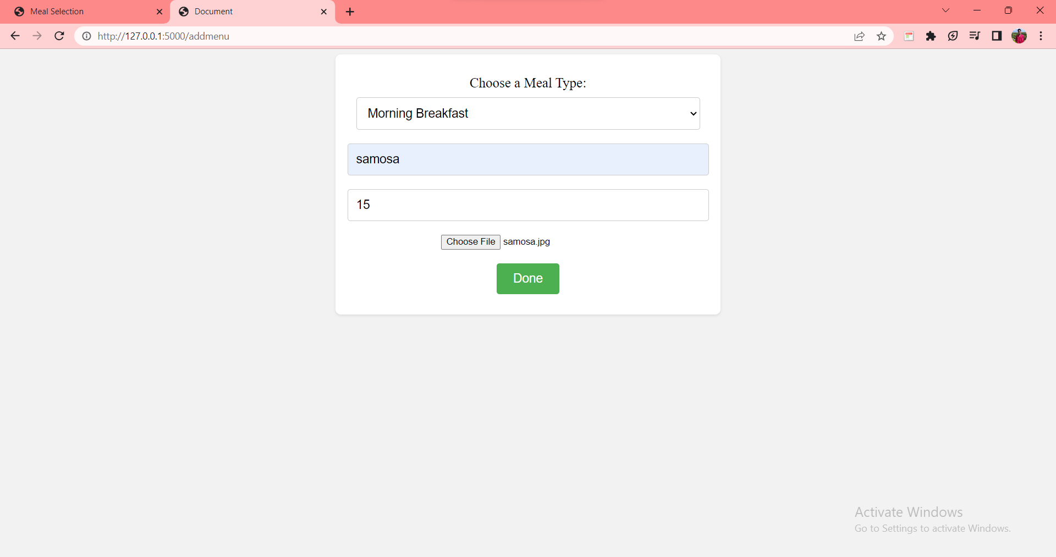
Selecting a meal

Slide 10
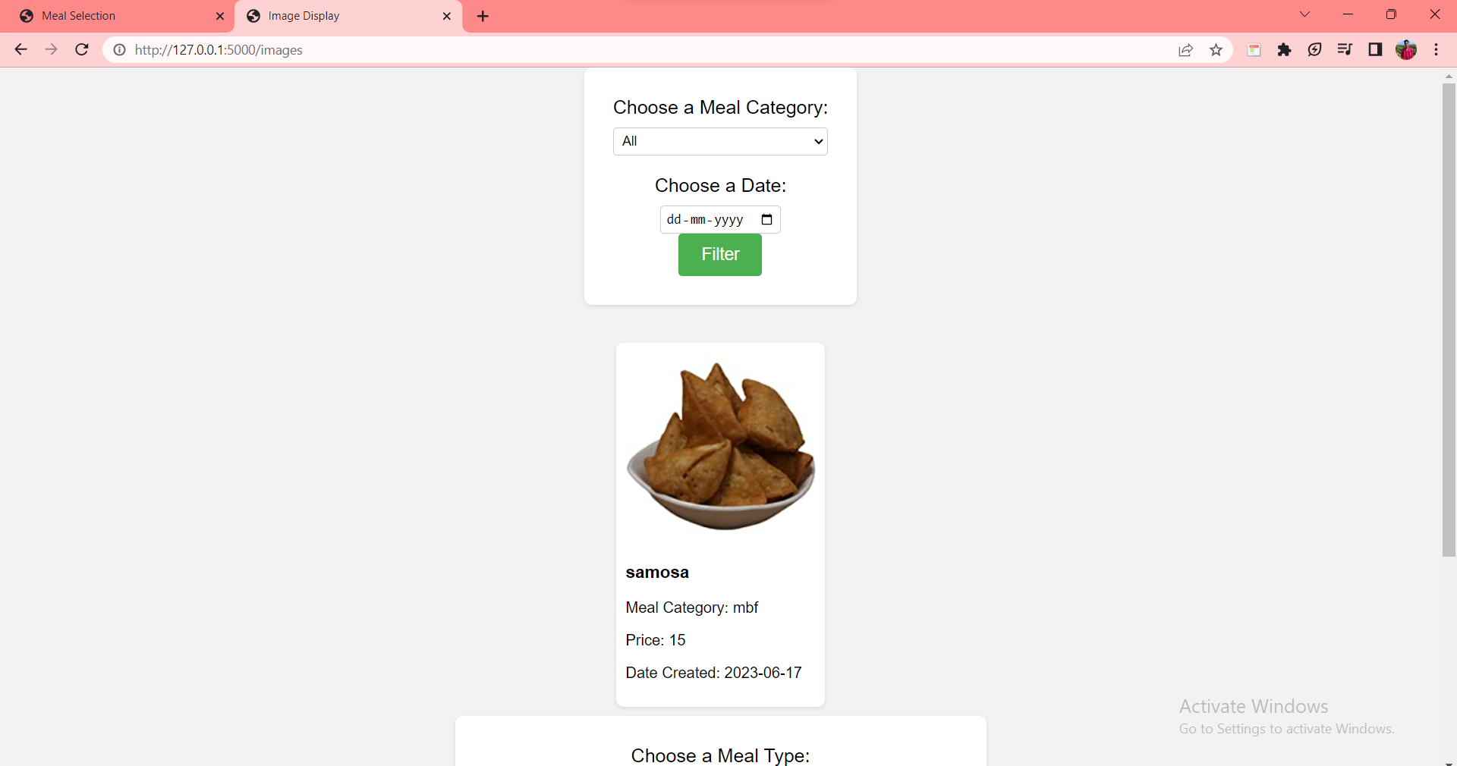
See what admin selected

Slide 11
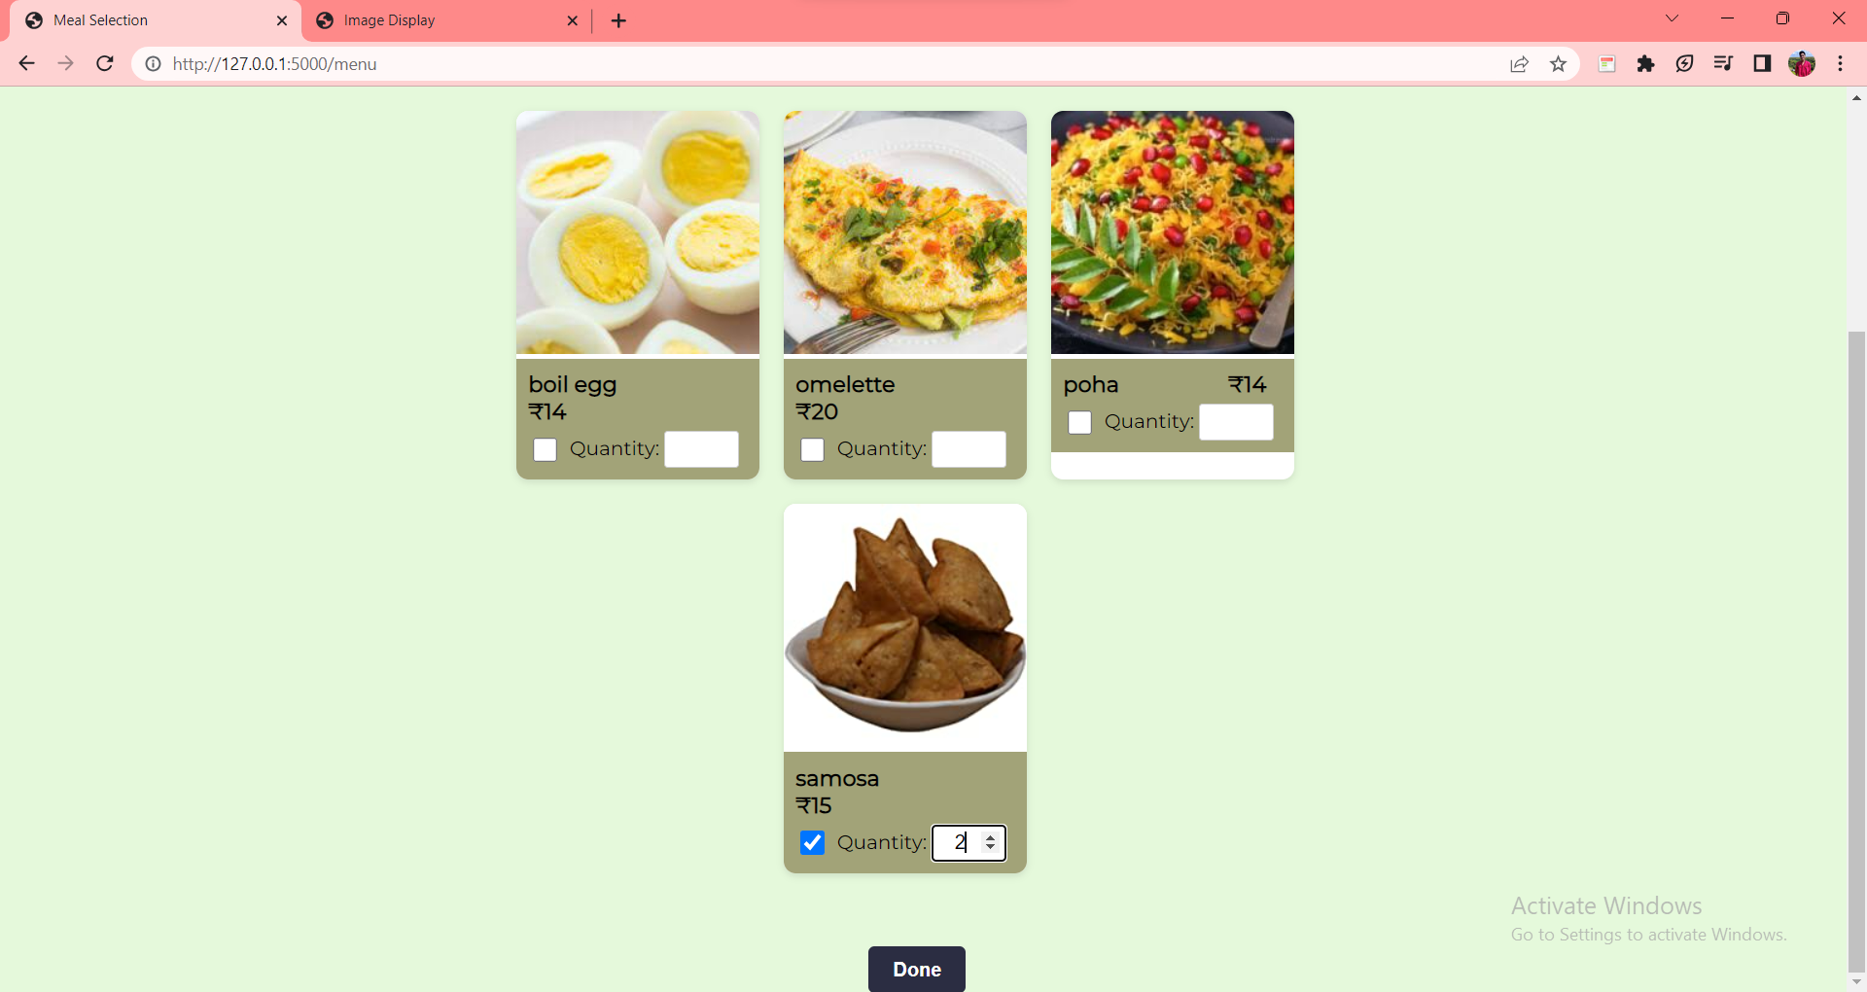
New Meal Added in user PAge

Slide 12
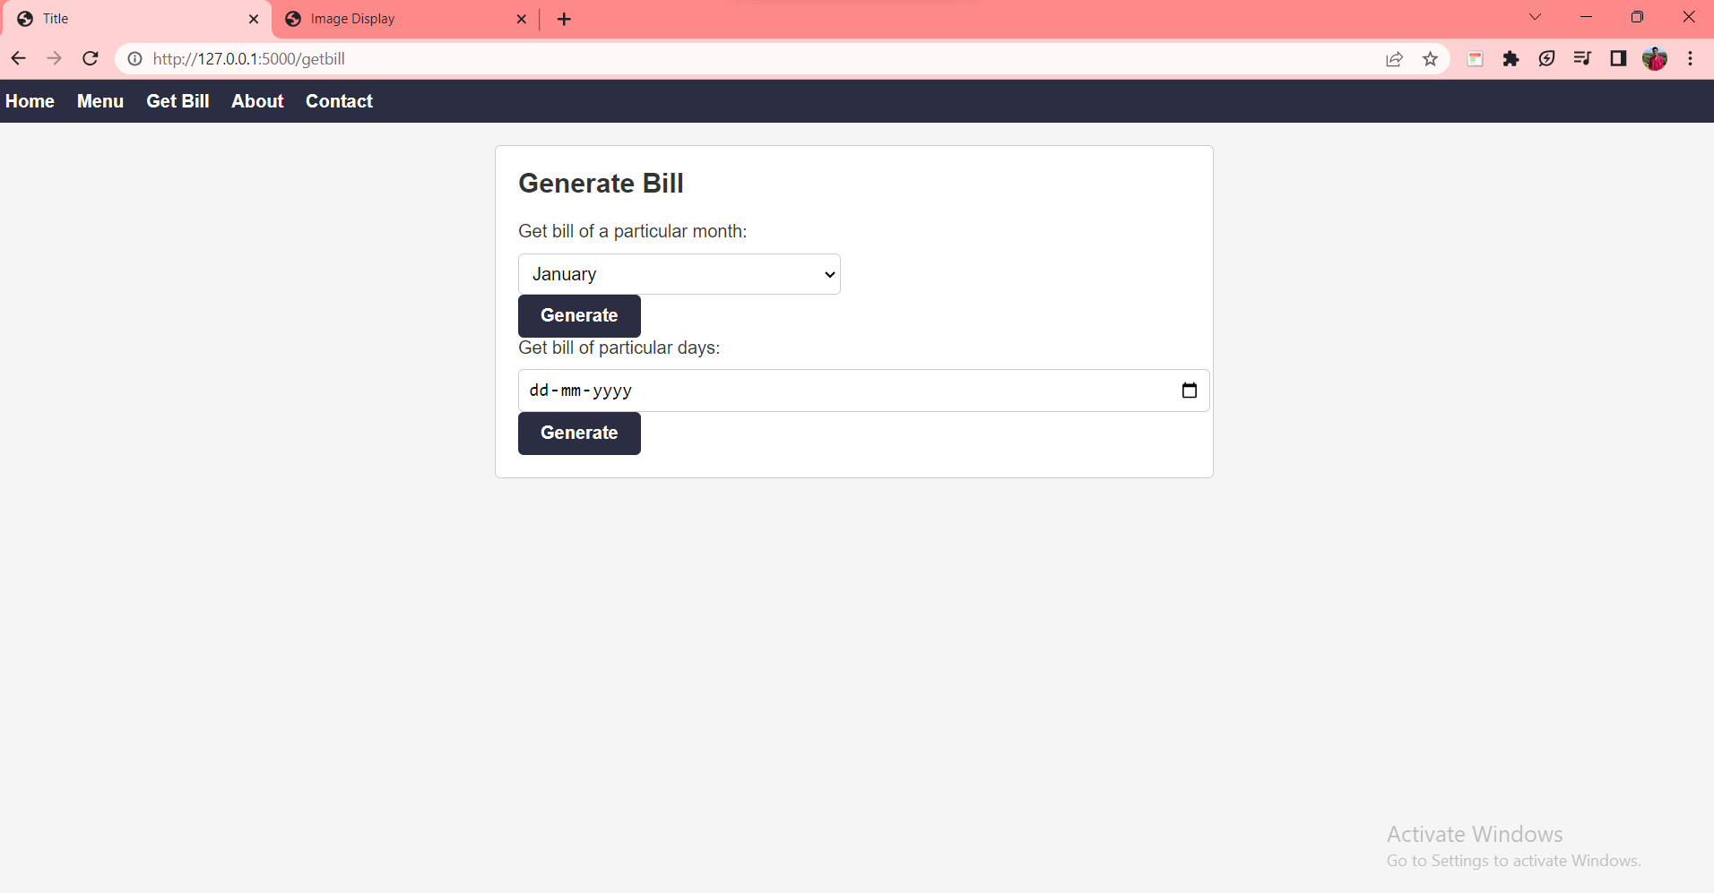
Bill generation of particular month or day

Slide 13
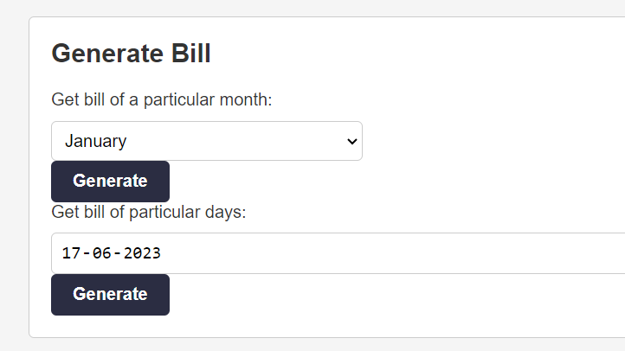
Bill selected

Slide 14
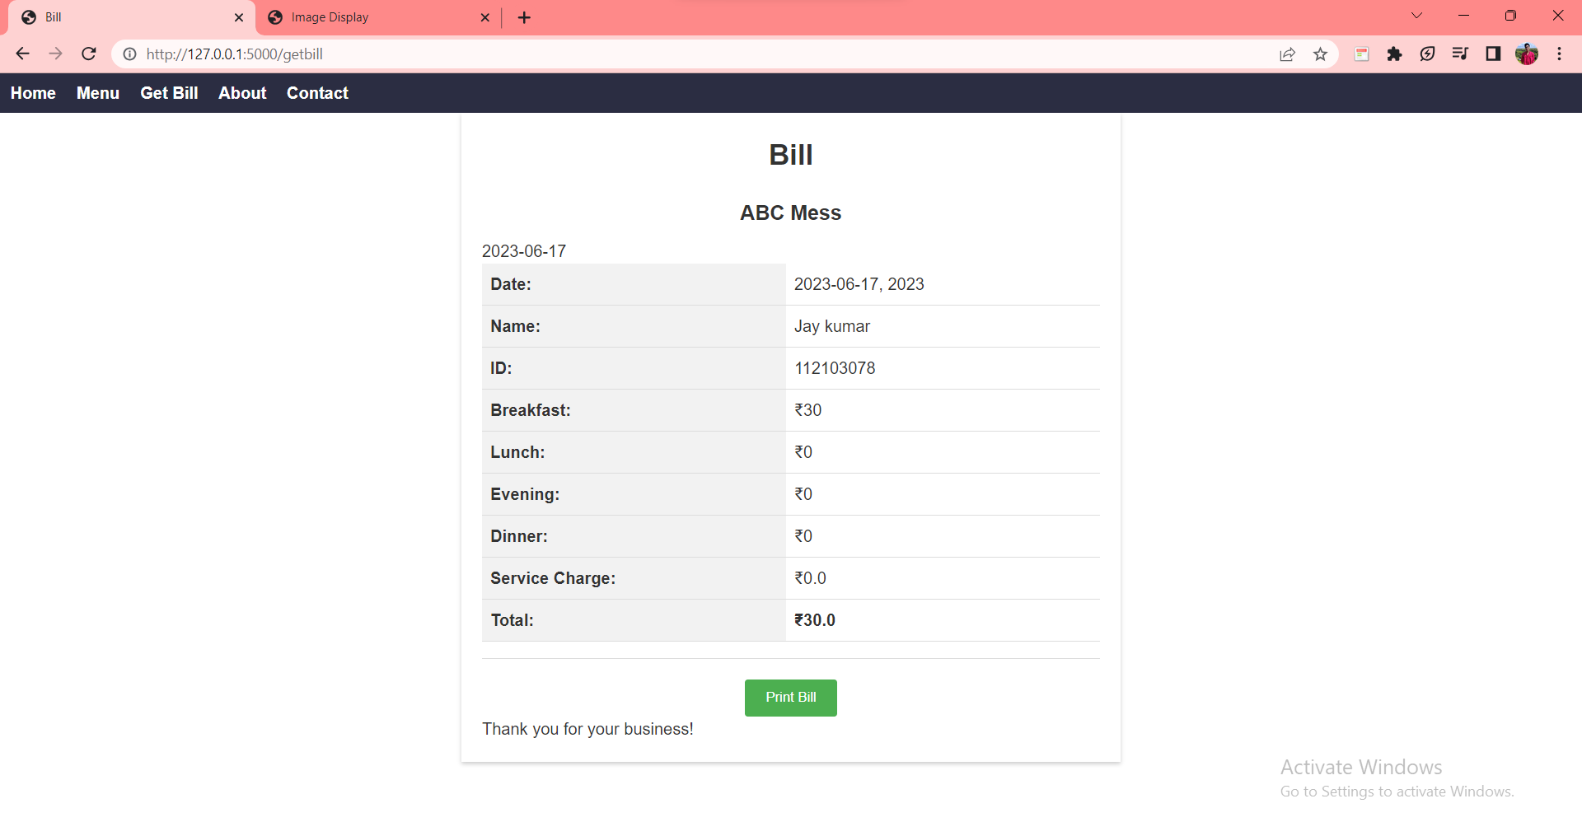
Generated Bill

Slide 15
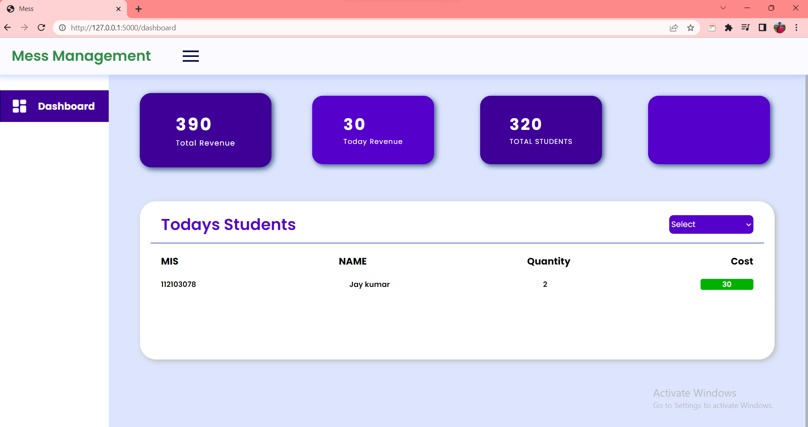
Admin dashboard

Slide 16

Conclusion:
"In conclusion, the Mess Management Website simplifies meal management in mess settings, improving efficiency, user experience, and transparency. It offers a scalable solution that can contribute to the success and growth of institutions in the food service industry."

Slide 17

Thank you

